Slide 1
Subtype Identification and Clustering of single-cell RNA-seq data by nearest neighbor searching
Zhixin Li
July 13, 2018
Notes:
Module-based

Slide 2
Overview
Current clustering methods for scRNAseq and limitations
Hypothesis and Inspiration
Algorithm of MSIC
Performance on simulated dataset
Application in real cases
Conclusions

Slide 3
Clustering and the role of marker
Heterogeneity
developmental/pathogenic mechanism
Before scRNA-seq:
Morphology
Surface protein
Marker gene: uniquely/highly expressed gene for certain cells.
Cell identity: marker can reliably distinguish between two or more clusters.
Crucially, marker genes can be used for experimental validation.
Marker genes may also be used for in situ imaging of the putative cell population.

Slide 4
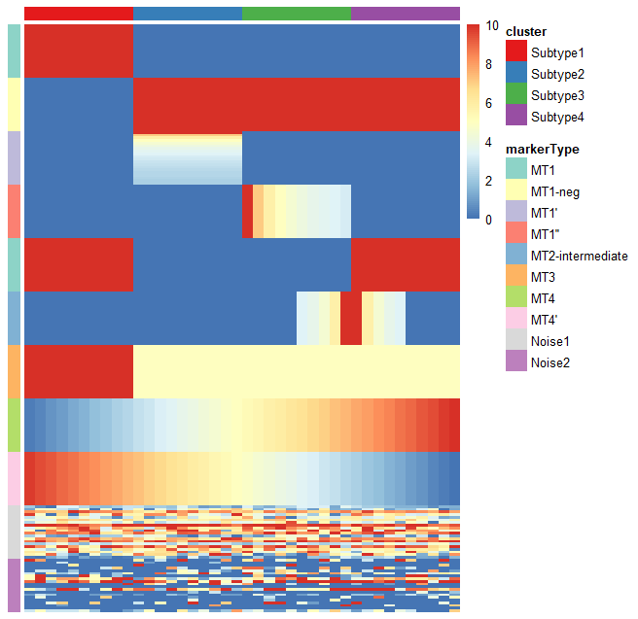
Hypothesis
Marker types (MTs)
MT1 – uniquely expressed genes with the same expression level
MT1-neg – negative markers of MT1
MT1’ – uniquely expressed genes with different expression levels
MT1’’ – uniquely expressed genes synergistic change across cells
MT2- intermediate – intermediate genes between two subtypes
MT3 – highly expressed genes in certain subtypes
MT4 – genes with gradually rising/falling expression
Noise – randomly expressed genes
Biological insights
Genes
Cells

Slide 5
Current clustering method and their limitations
SC3 (Kiselev et al., Nature Methods 2017) is based on PCA and spectral dimensionality reductions.
SIMLR (Wang et al., Nature Methods 2017) is a kernel-based similarity learning method.
Seurat (Butler et al., Nature Biotechnology 2018) is a community detection approach similar to SNN-Cliq
t-SNE + k-means (10x Genomics official method)
SINCERA (Guo et al., 2015) is based on hierarchical clustering
pcaReduce (žurauskienė and Yau, 2016) combines PCA, k-means and “iterative” hierarchical clustering.
SNN-Cliq (C. Xu and Su, 2015) is a graph-based method.
Find the relationship (e.g. distance) between cells based on the features (gene)
Limitations:
Inevitably need to choose a k for clustering (subjectivity)
feature selection is crucial
Can’t avoid some confounding genes (cell cycle, apoptosis, may largely affect the clustering)
Risk of overfitting, because of p >> n (p denotes feature count, n denotes sample size)
Computationally expensive, especially for large dataset (>1000 cells)
Notes:
For clustering this means the clusters you are finding only exist in your dataset and can't be seen in new data.
Your algorithm might find two clusters in the dataset that don't exist for new data, because both clusters are actually subset of one bigger cluster. Your algorithm is overfitting, your clustering is too fine (e.g. your k is too small for k-means) because you are finding groupings that are only noise.

Slide 6
Inspiration
Correlation between the genes in the same marker module is higher.
Marker modules locate in the local centers (gene clusters with high density) in the gene-gene correlation network.
Can we identify all the marker modules first and then using them to do the clustering?
Notes:
New strategy for scRNA-seq clustering

Slide 7
10% dropout rate
Marker modules still can be captured
by correlation relationship.
Dropout events: high chance of missing nonzero entries as zero, due to the technical and biological noise.
(low number of RNA transcriptomes and the stochastic nature of the gene expression pattern)

Slide 8
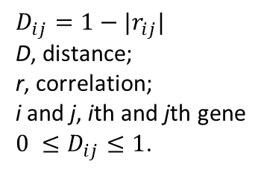
Hypothesis
$$D_{ij}=1−|r_{ij}|$$
D, distance;
r, correlation;
i and j, ith and jth gene
$0 ≤D_{ij}≤1$.
A robust marker module can be defined by a few (5-10) core markers.
Core markers identification is a question of local center identification.
“Slicing and scanning” method can effectively detect the local center of a network.
Nearest neighbor searching can be used for full marker module identification.
Subtypes can be inferred by the marker modules.
Noise gene
Marker module2
Marker module1
Marker module3
Rare marker module
Local center
Gene-gene correlation network
Notes:
How to show gene-gene network, hclust
Or show pca plot of genes

Slide 9
MSIC overview
Cell outlier detection
Build gene-gene correlation network
Identify local centers of the network
Define and classify the marker modules
Infer the subtypes by marker modules
Identify full marker modules by nearest searching

Slide 10
subtype2
outlier
outlier
outlier
Main part
subtype1
Rare subgroup
subtype3
Classical version: observations lying “far away” from the main part of a dataset and probably not following the assumed model (Becker and Gather, 1999).
Single cell version: cells far away from any subgroups in a heterogeneous cell population. p >> n (p denotes feature count, n denotes sample size).
Purpose: removing the extreme outliers far away from any cells and keep the rare cell populations.
Notes:
Correlation is the basic for further analysis.
Correlation, especially Pearson correlation, is very sensitive to strong outliers.
Make a cartoon plot to show the difference.
Why need dimension reduction?
Why current method can not be used?
How my method can detect if there is a outlier?

Slide 11
Public dataset:
Pollen et al.,2014, NBT
Cells: 249
Genes: 6982
Ground-truth:
Clusters
Markers and non-markers
Conclusion: extreme outliers will seriously affect the correlation between markers.
Notes:
Show the necessary for outlier detection
Quantify the effect of outlier
Few outlier will not affect the correlation
Show why spearman is better than pearson
Conclusion: extreme outlier will seriously affect the correlation between markers.

Slide 12
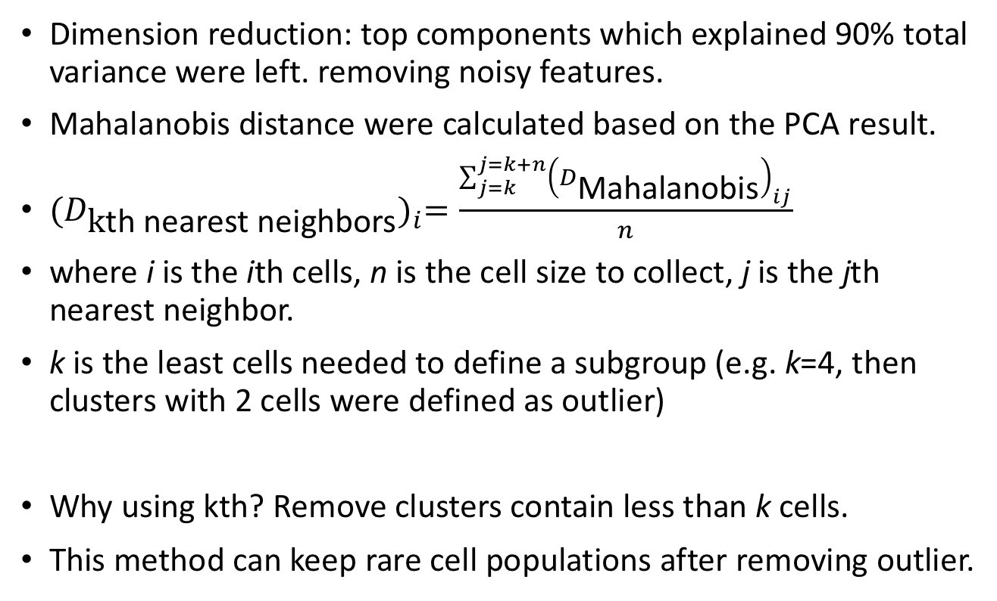
Extreme Outlier detection
Dimension reduction: top components which explained 90% total variance were left. removing noisy features.
Mahalanobis distance were calculated based on the PCA result.
${(D_{\text{k}\text{th} \text{nearest} \text{neighbor}\text{s}})}_{i}=\frac{\sum_{j=k}^{j=k+n}{{\left(D_{\text{Mahalanobis}}\right)}_{ij}}}{n}$
where i is the ith cells, n is the cell size to collect, j is the jth nearest neighbor.
k is the least cells needed to define a subgroup (e.g. k=4, then clusters with 2 cells were defined as outlier)
Why using kth? Remove clusters contain less than k cells.
This method can keep rare cell populations after removing outlier.
Add one
Notes:
why removing outlier is necessary? using simulated data to explain this point
why current outlier detection method is not suitable? use ground truth to demonstrate this point, compare different tools (removing the rare populations)
why using dimension reduction (cite paper)? top 100 or 95% explained variance PCs
try different dimension reduction method (PCA and DM), compare the results
outlier detection algorithm, minNum

Slide 13
Results (2 dimensions)
Public dataset:
Deng et al.,2014, Science
Cells: 268
Genes: 22431
Ground-truth:
Clusters
Markers and non-markers
cluster1
cluster2
cluster3
our tool: k=4, n=5
Compare to mvoutlier
Simulation: only 1, 2 and 4 cells were left for cluster1, cluster2 and cluster3 to simulate some outliers.
Our method can robustly identify the outliers (cluster1 and cluster2) and keep the rare cluster3.
mvoutlier fail to detected the simulated outliers.

Slide 14
deng
pollen

Slide 15
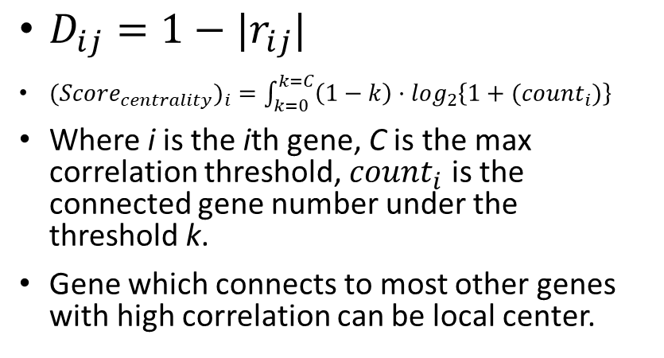
“Slicing and scanning”
 | 0.05 | 0.1 | 0.15 | 0.2 | 0.25 | 0.3 | 0.35 | 0.4 | 0.45 | 0.5 | 0.55 | 0.6 | 0.65 | centrality
CLDN6 | 0 | 0 | 5 | 16 | 33 | 63 | 91 | 136 | 200 | 278 | 393 | 549 | 786 | 23.12
CLDN7 | 0 | 0 | 5 | 18 | 30 | 54 | 85 | 134 | 196 | 268 | 376 | 551 | 770 | 22.99
KRT18 | 0 | 0 | 3 | 14 | 34 | 53 | 90 | 125 | 183 | 266 | 379 | 543 | 767 | 22.85
CLDN4 | 0 | 0 | 2 | 16 | 28 | 52 | 88 | 129 | 192 | 265 | 373 | 530 | 750 | 22.77
ANXA3 | 0 | 0 | 1 | 12 | 30 | 57 | 96 | 129 | 187 | 274 | 381 | 531 | 761 | 22.76
EPCAM | 0 | 0 | 2 | 15 | 29 | 49 | 81 | 127 | 184 | 258 | 372 | 519 | 744 | 22.66
ARHGAP29 | 0 | 0 | 2 | 13 | 27 | 52 | 85 | 124 | 177 | 262 | 370 | 520 | 729 | 22.62
KRT19 | 0 | 0 | 1 | 10 | 26 | 53 | 84 | 125 | 179 | 261 | 371 | 553 | 776 | 22.59
KRT8 | 0 | 0 | 2 | 9 | 29 | 47 | 80 | 118 | 176 | 252 | 363 | 535 | 755 | 22.50
TACSTD2 | 0 | 0 | 1 | 8 | 23 | 49 | 79 | 118 | 177 | 250 | 362 | 503 | 718 | 22.30
SPINT2 | 0 | 0 | 0 | 6 | 26 | 48 | 80 | 115 | 176 | 251 | 362 | 525 | 745 | 22.21
WNT6 | 0 | 0 | 0 | 4 | 23 | 45 | 78 | 114 | 172 | 243 | 364 | 515 | 737 | 22.05
ACSM3 | 0 | 0 | 0 | 4 | 17 | 40 | 72 | 115 | 161 | 238 | 340 | 483 | 695 | 21.76
CDH6 | 0 | 0 | 0 | 3 | 19 | 45 | 75 | 111 | 162 | 234 | 331 | 479 | 691 | 21.75
ANXA2 | 0 | 0 | 0 | 8 | 14 | 37 | 58 | 100 | 148 | 221 | 319 | 482 | 677 | 21.55
CDH1 | 0 | 0 | 0 | 3 | 18 | 37 | 64 | 98 | 156 | 221 | 324 | 471 | 687 | 21.50
PLP1 | 0 | 0 | 0 | 1 | 10 | 33 | 69 | 102 | 153 | 234 | 353 | 515 | 727 | 21.39
EFNA1 | 0 | 0 | 0 | 2 | 16 | 35 | 65 | 93 | 150 | 223 | 322 | 467 | 671 | 21.35
SEMA3D | 0 | 0 | 0 | 2 | 18 | 37 | 64 | 102 | 144 | 225 | 309 | 447 | 646 | 21.34
VAMP8 | 0 | 0 | 0 | 2 | 17 | 34 | 63 | 100 | 144 | 215 | 316 | 459 | 671 | 21.32
CD24 | 0 | 0 | 0 | 4 | 14 | 33 | 62 | 103 | 148 | 212 | 307 | 454 | 622 | 21.30
DMKN | 0 | 0 | 0 | 1 | 11 | 32 | 67 | 101 | 148 | 211 | 331 | 482 | 700 | 21.23
CYP26A1 | 0 | 0 | 0 | 2 | 11 | 31 | 58 | 95 | 146 | 213 | 304 | 433 | 631 | 21.04
MYL12B | 0 | 0 | 0 | 2 | 11 | 28 | 59 | 96 | 144 | 213 | 301 | 436 | 646 | 21.03
PDLIM1 | 0 | 0 | 0 | 1 | 14 | 31 | 59 | 95 | 143 | 213 | 304 | 427 | 633 | 21.01
TSTD1 | 0 | 0 | 0 | 0 | 12 | 34 | 66 | 94 | 144 | 207 | 304 | 454 | 641 | 20.93
LY6E | 0 | 0 | 0 | 3 | 10 | 30 | 51 | 89 | 137 | 203 | 291 | 416 | 603 | 20.87
TINAGL1 | 0 | 0 | 0 | 0 | 12 | 31 | 55 | 95 | 136 | 205 | 291 | 426 | 622 | 20.73
PERP | 0 | 0 | 0 | 0 | 9 | 27 | 58 | 82 | 135 | 198 | 291 | 458 | 654 | 20.64
RPS2 | 0 | 0 | 1 | 7 | 13 | 35 | 54 | 68 | 108 | 161 | 242 | 328 | 510 | 20.56
TDRP | 0 | 0 | 0 | 0 | 8 | 29 | 50 | 90 | 132 | 202 | 281 | 417 | 619 | 20.51
SLC2A3 | 0 | 0 | 0 | 2 | 5 | 24 | 48 | 87 | 129 | 183 | 287 | 411 | 590 | 20.46
RPS3 | 0 | 0 | 1 | 6 | 14 | 36 | 57 | 73 | 101 | 152 | 215 | 305 | 473 | 20.39
EDNRB | 0 | 0 | 0 | 1 | 3 | 20 | 50 | 84 | 122 | 183 | 293 | 438 | 656 | 20.32
ATP1B3 | 0 | 0 | 0 | 0 | 1 | 25 | 51 | 91 | 139 | 201 | 300 | 463 | 675 | 20.28
SEMA3A | 0 | 0 | 0 | 0 | 4 | 22 | 44 | 74 | 121 | 185 | 285 | 424 | 621 | 20.10
SPP1 | 0 | 0 | 0 | 0 | 3 | 20 | 45 | 86 | 121 | 178 | 273 | 425 | 624 | 20.05
KRT7 | 0 | 0 | 0 | 0 | 6 | 20 | 42 | 68 | 117 | 179 | 257 | 391 | 609 | 19.96
TPM1 | 0 | 0 | 0 | 0 | 4 | 25 | 44 | 75 | 116 | 175 | 251 | 393 | 557 | 19.91
PTN | 0 | 0 | 0 | 0 | 2 | 16 | 43 | 78 | 116 | 176 | 265 | 408 | 606 | 19.77
$D_{ij}=1−|r_{ij}|$
${({Score}_{centrality})}_{i} =\int_{k=0}^{k=C}{\left(1−k\right)·\log_{2}\left\{1+({count}_{i})\right\}}$
Where i is the ith gene, C is the max correlation threshold, ${count}_{i}$ is the connected gene number under the threshold k.
Gene which connects to most other genes with high correlation can be local center.
The area
Notes:
No overlap, so you can get the right area

Slide 16
Nearest neighbors searching
Step1: define the local centers, initialize the marker module
Step2: Iteratively find the nearest neighbor of the marker module
Step3: update the marker module
Step4: until the new nearest neighbor far away from half of the genes (or center) in the marker module under a certain threshold
Noise gene
Local center
Marker module
Gene-gene correlation network

Slide 17
Full module identification (KNN)
A new gene is classified by a majority vote of its neighbors, with the object being assigned to the marker module most common among its k nearest neighbors.
K was chosen by cross validation
Kd tree was used to improve the searching efficiency
Noise gene
Marker module2
Marker module1
Marker module3

Slide 18
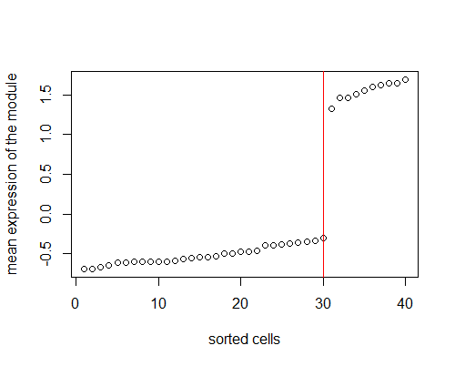
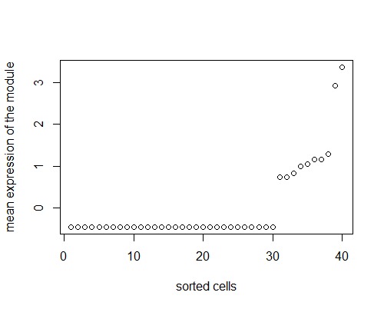
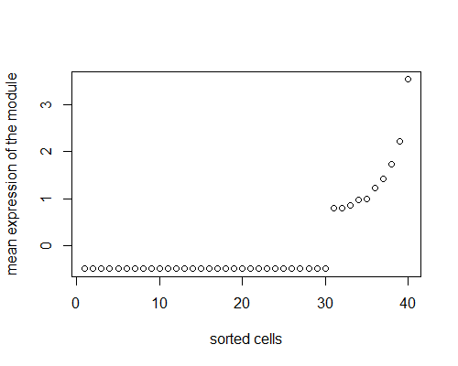
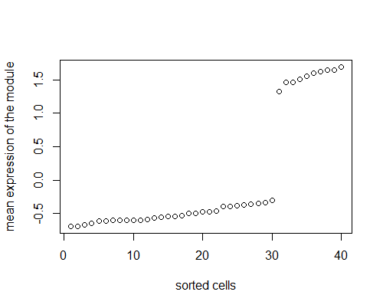
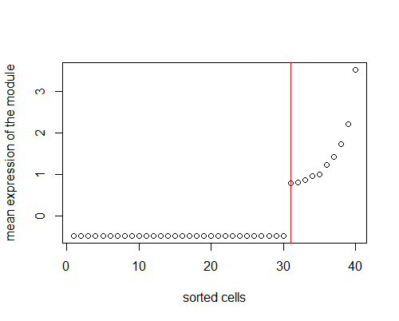
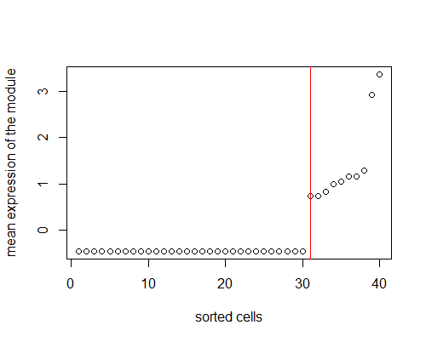
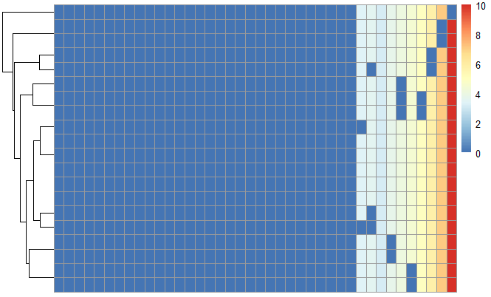
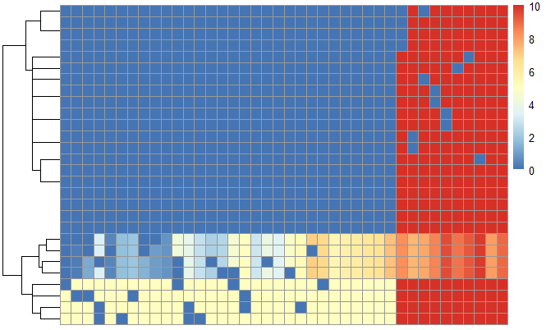
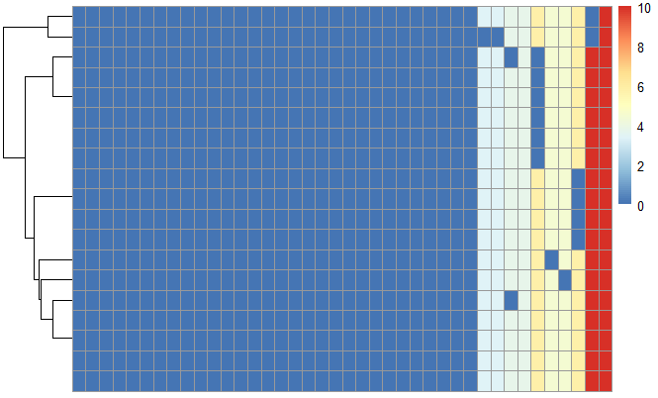
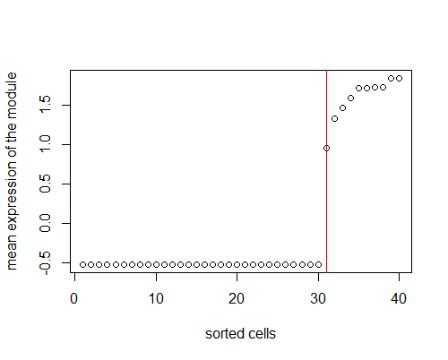
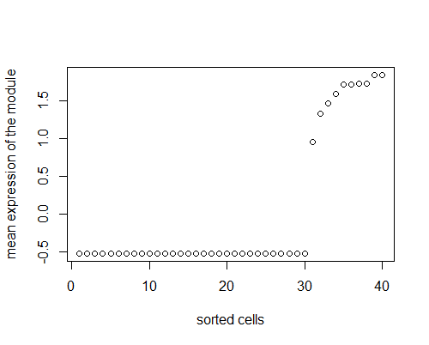
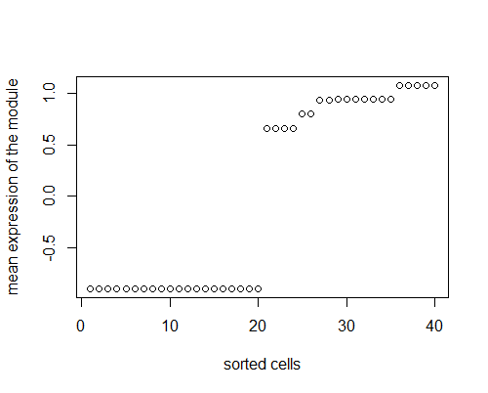
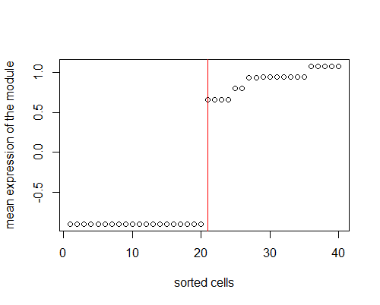
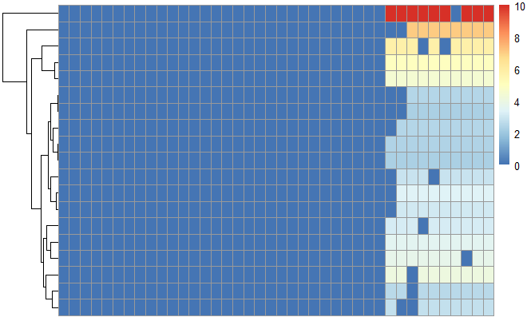
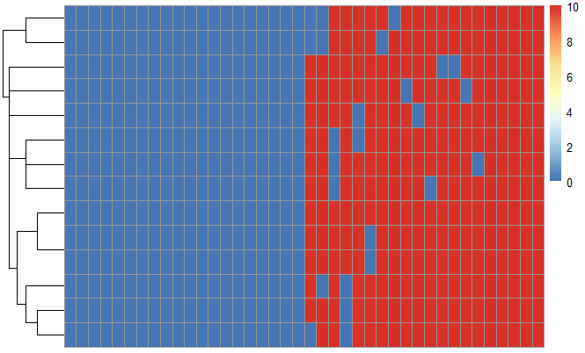
breakpoint
Notes:
Subtypes inference
How to find this

Slide 19
Performance on simulated dataset
Finally, we will get all the marker modules, and the sum expression plot.
Clustering inference can be made.
Our method can identify all the subtypes
But SC3, SIMLR and other tools can not
Notes:
To compare two sets of clustering labels we can use adjusted Rand index. The index is a measure of the similarity between two data clusterings. Values of the adjusted Rand index lie in [0,1] interval, where 1 means that two clusterings are identical and 0 means the level of similarity expected by chance.

Slide 20
Performance on real dataset
Smart-seq:
100-1000 cells
3k-10k expressed genes
Low dropout rate
10x genomics
1k-10k cells
500-3000 expressed genes
High dropout rate

Slide 21
Smart-seq dataset

Slide 22
Co-expresssion network analysis
Improvements
Compare to WGCNA

Slide 23
Time consumption comparison

Slide 24
Key advantages - conclusion
No need to choose a k for clustering
No need to do feature selection
Can identify negative markers
Can identify the intermediate subgroup
Can identify rare subgroup
Greatly reduce the computing resource (at least 10 folds)
More intuitive strategy
Great benefit for downstream analysis

Slide 25
Dropout rate may largely affect the result.

Slide 26
To do
Write a paper
Write a R package (submit to Bioconductor)

